Slide 1

Sankari Swaroop Anupindi
Sandeep Suresh Akhare
XML PARSING

Slide 2
Agenda
Problem Set
Solutions
Performance and scalability issues Scalability Issues
Tool
    Design considerations
    Design
    Features
Learning
Future enhancement
Q&A

Slide 3
Problem Set
Objective
Define a development approach to Parse/Load/Search an XML document of size ~1GB
Description
Project Gutenberg (www.gutenberg.org) maintains a list of books in a RDF format.
You need to provide the following APIs that will allow you to use the contents:
//Given a start and end index provides allows to incrementally get the books from the list(ala google way)
public List<Book> GutenbergBookManager.getBooks(int start, in end)
// Given an ID of the book searches the document return the book details
public Book GutenbergBookManager.getBook(String id)
// Given the search phrase returns the list of the books with matching subject (word occurring anywhere in the subject line)
public List<Book> GutenbergBookManager.searchBook(String subject)
Assume that you do not have the luxury to dump the data into a relational database

Slide 4
Performance and Scalability Issues
Processing a large xml document may cause a high CPU,memory and bandwidth utilization
Resource consumption :
Extreme memory consumption
Bandwidth utilization
Time constraint

Slide 5
Design Consideration
What we need ?
Parse a large Xml Document without storing in relative database
Should be Productive and efficient
What we did
Appropriate design decisions can help you address many XML-related performance issues early in the application life cycle
Choosen the appropriate XML class for the job.
Used streaming interfaces.
Consider combining XmlReader and XmlDocument
On the XmlReader used the MoveToContent and Skip methods
We can read up to 2 GB using XmlReader as it only loads 4-kilobyte (KB) buffers into memory

Slide 6
Code
while (!_xmlReader.EOF)
{
// check Node type,node name ,match attribute which is id to search if((_xmlReader.MoveToContent() == XmlNodeType.Element && _xmlReader.Name == "pgterms:etext" && _xReader.GetAttribute(0) == name))
{
// Load the node in the memory to retrieve book details
}
else
{
        // skip the whole node as it is not of use i.e. also skips all its child element also
_xReader.Skip();
_xReader.MoveToContent();
}
}

Slide 7
Design Contd.
        <pgterms:etext rdf:ID="etext14253">
        <dc:publisher>&pg;</dc:publisher>
        <dc:title rdf:parseType="Literal">Flames</dc:title>
        <dc:rights rdf:resource="&lic;" />
        .
        .
        </pgterms:etext>
        <pgterms:etext rdf:ID="etext14131">
        <dc:publisher>&pg;</dc:publisher>
        <dc:title rdf:parseType="Literal">The Bay State Monthly 1885</dc:title>
        .
        .
        </pgterms:etext>
XmlReader.Skip()

Slide 8
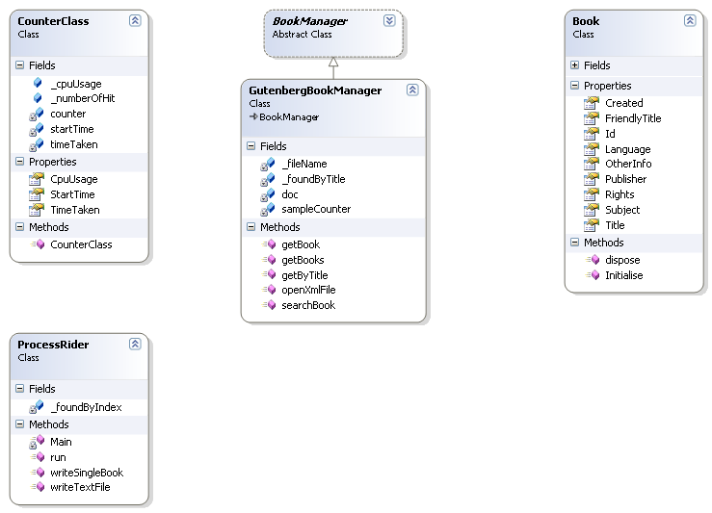
Design contd
Reads File
Reads xml file
Xml File

Slide 9
Features
Get By id:
When valid id is given function returns book of that id.
Get By Index:
When any indexes between first and last node are given
function returns list of books and write in output text file
Get By Title:
Search the book with title/subject/publisher/created etc
And returns list of books having this string .
CPU usage and time taken are showing in every function

Slide 10
Learning
Learned how to parse xml file in true means
Efficient way to get information from xml file
Drawbacks of DOM objects

Slide 11
Future Enhancement
Better reader than Xmlreader
A mechanism to add,edit,update the nodes in Xml file
Making the application as a web service
To improve the performance of the existing algorithm by 20%

Slide 12
Q&A
Q & A

Slide 13
Thank You

